Slide 1


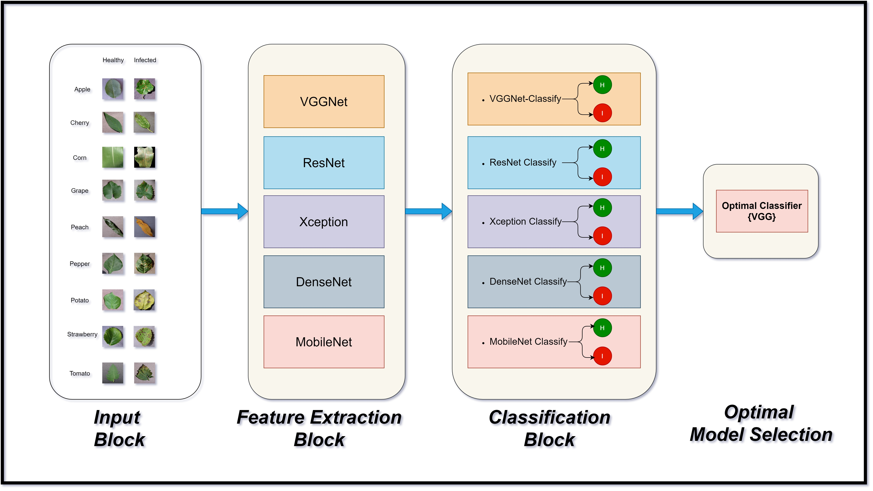
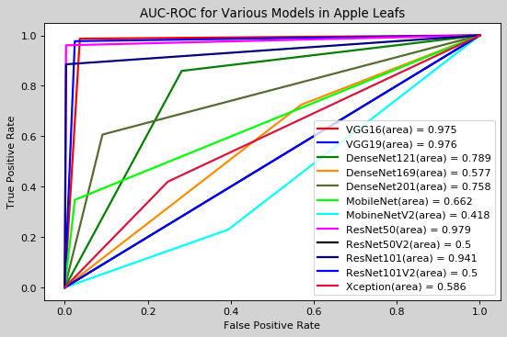
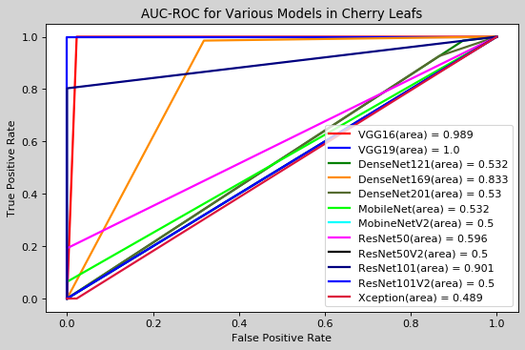
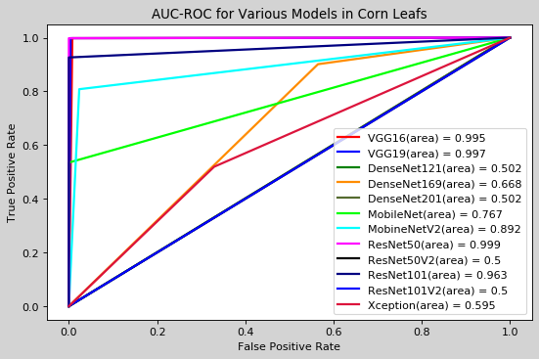
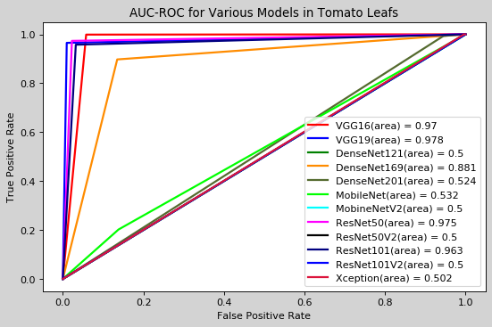
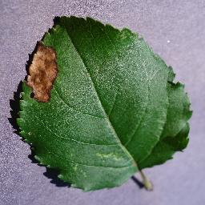
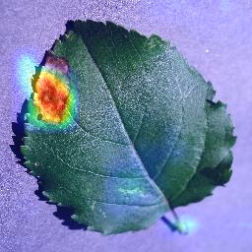
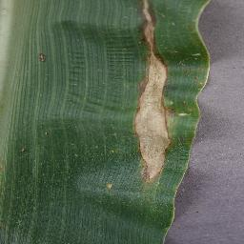
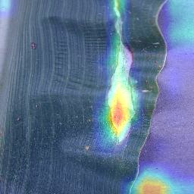
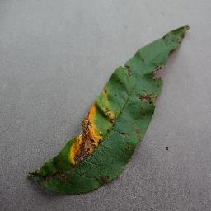
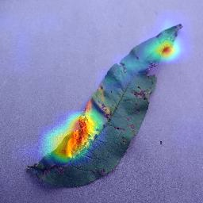
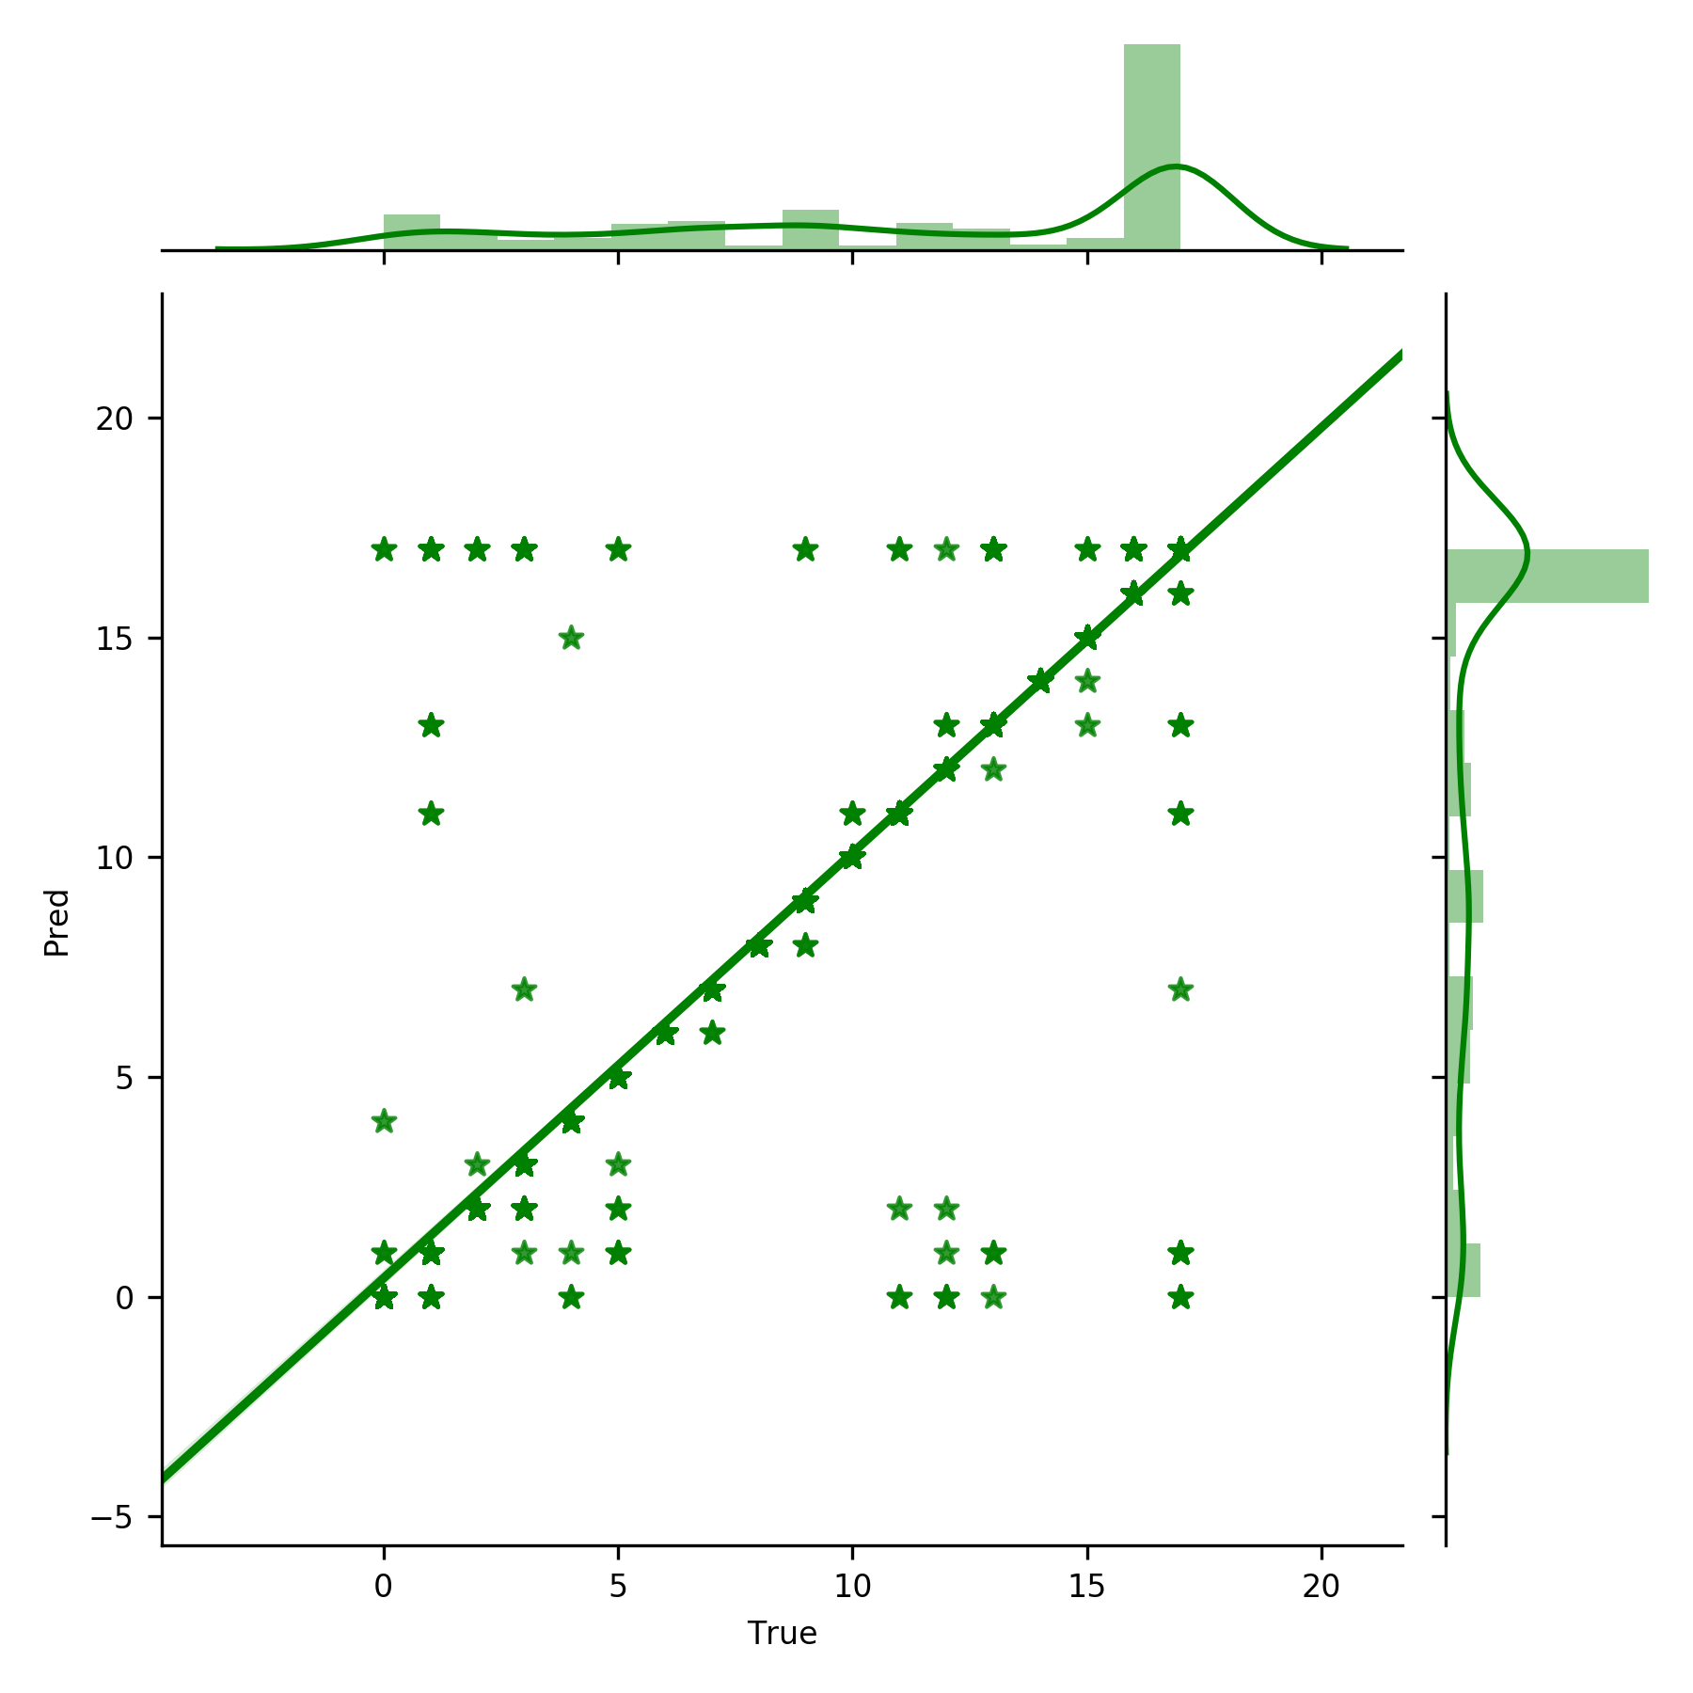
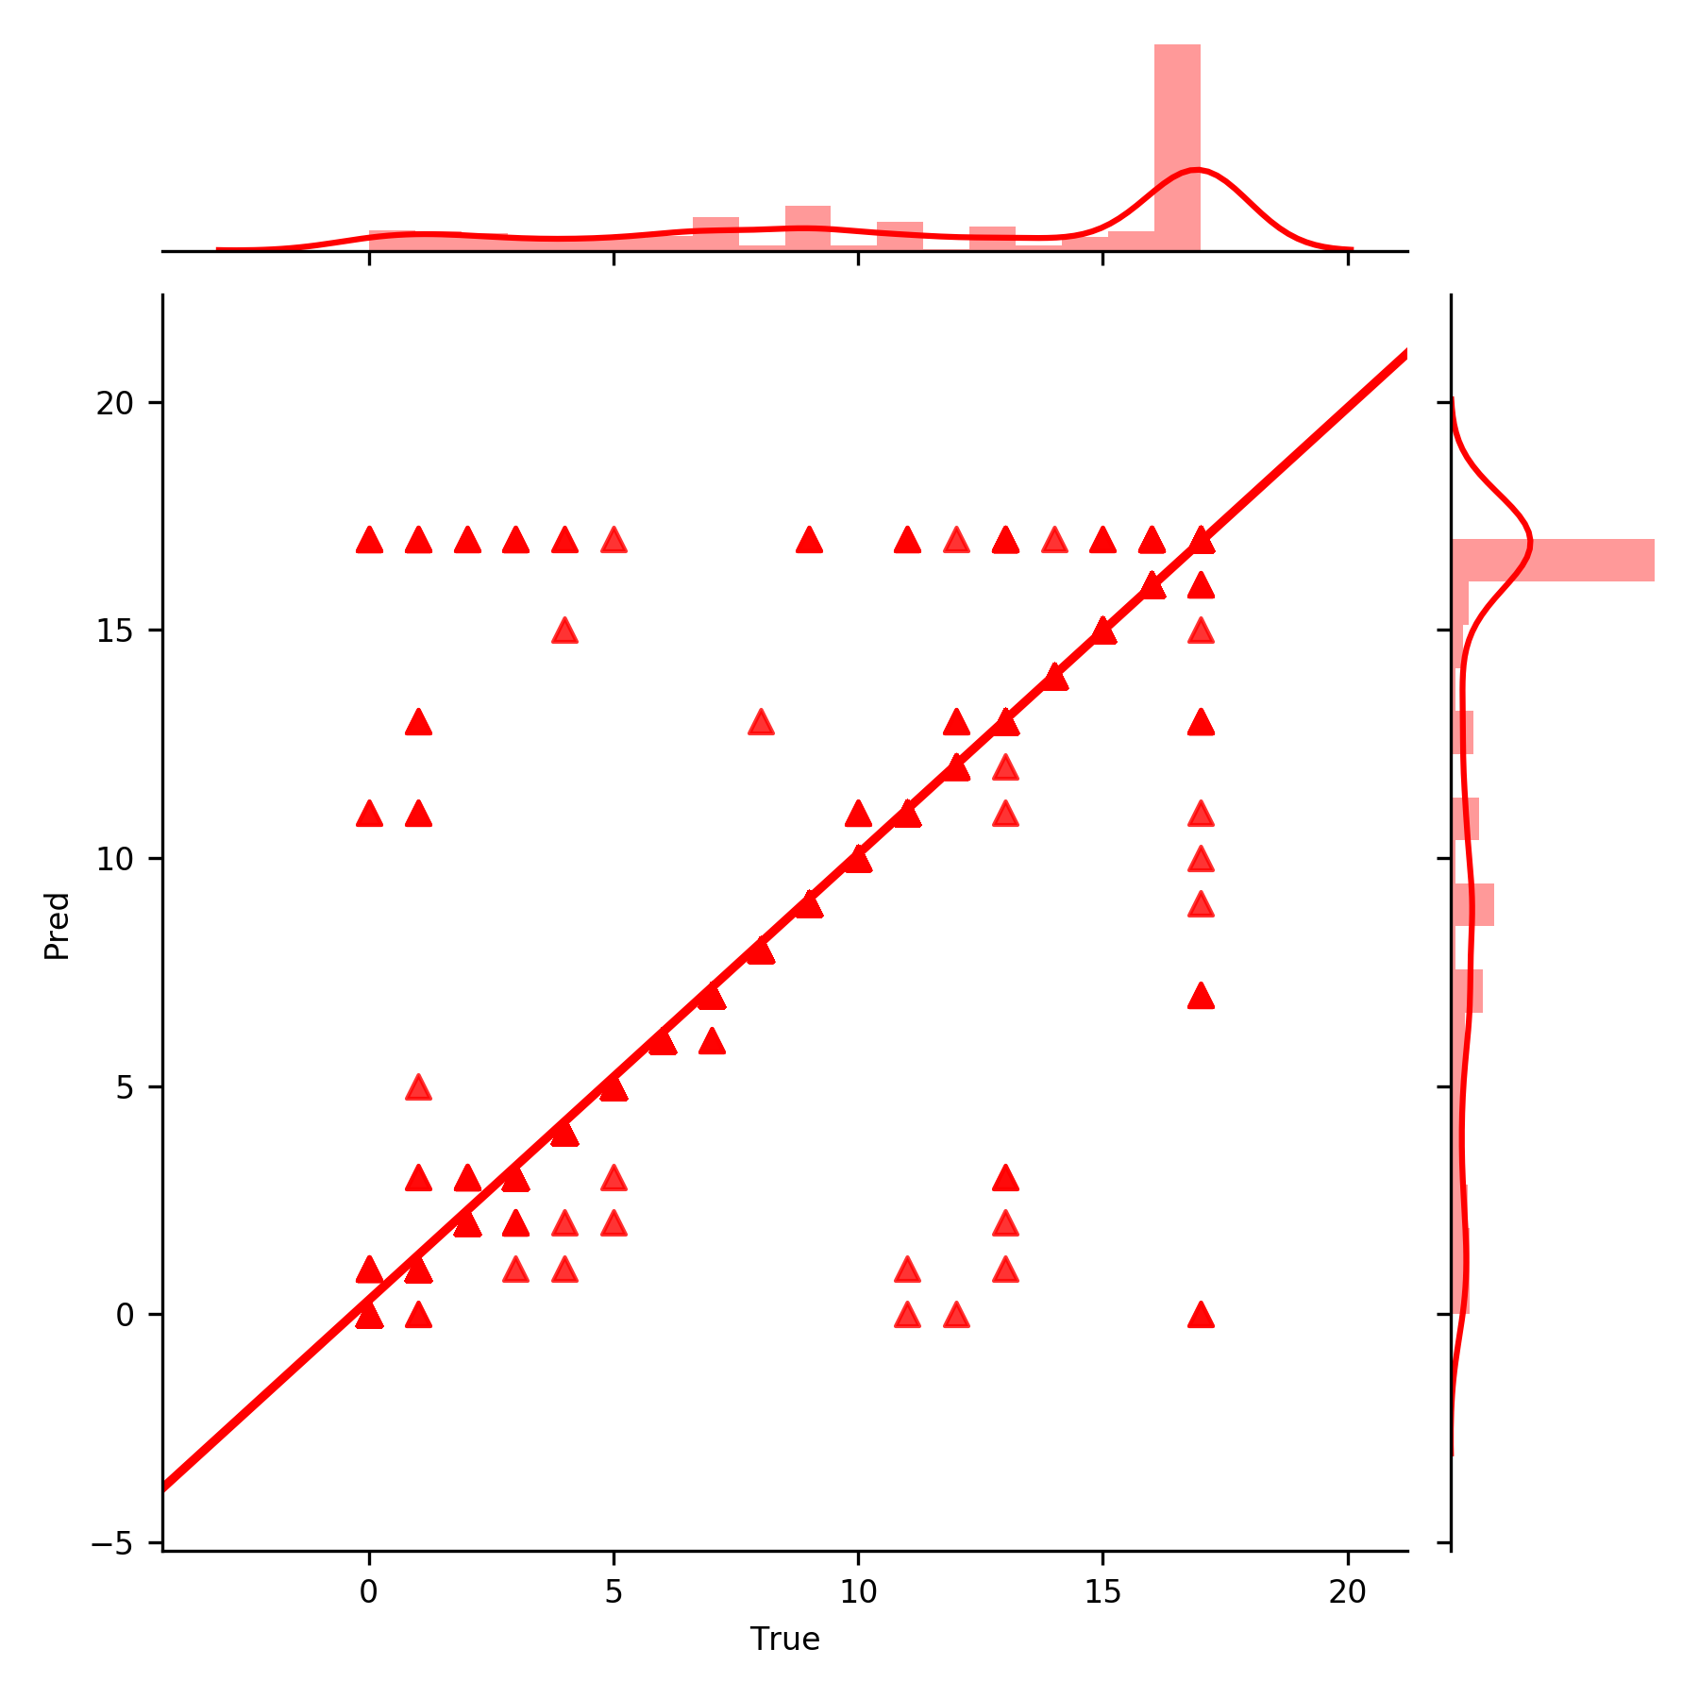
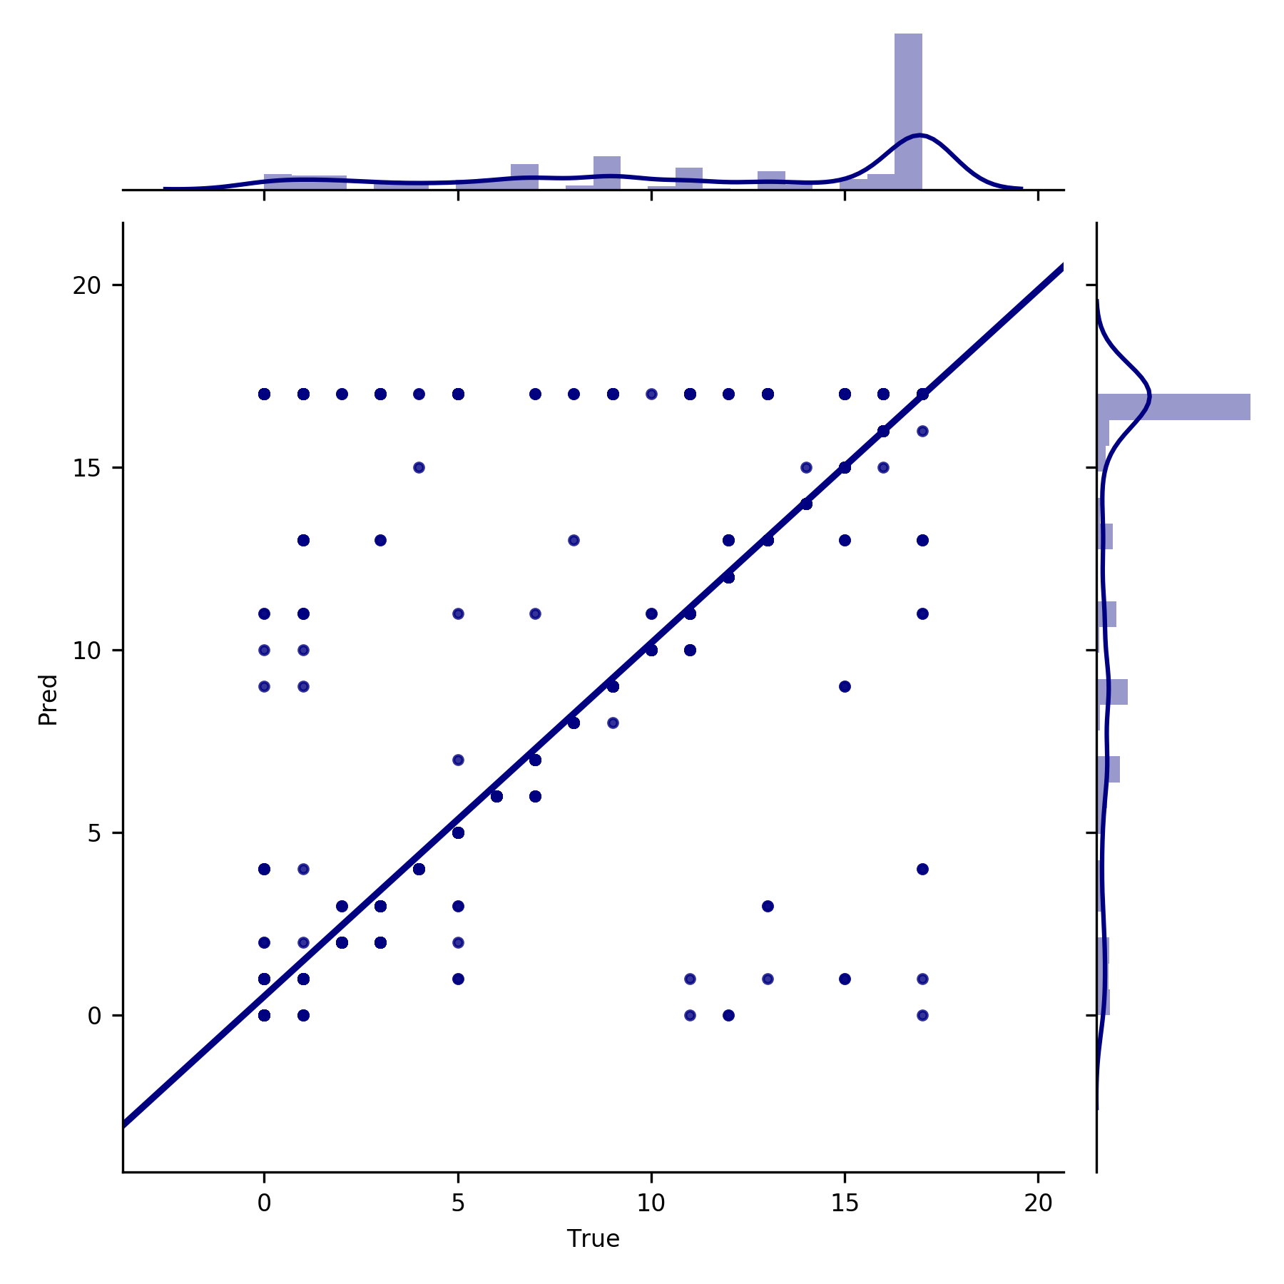
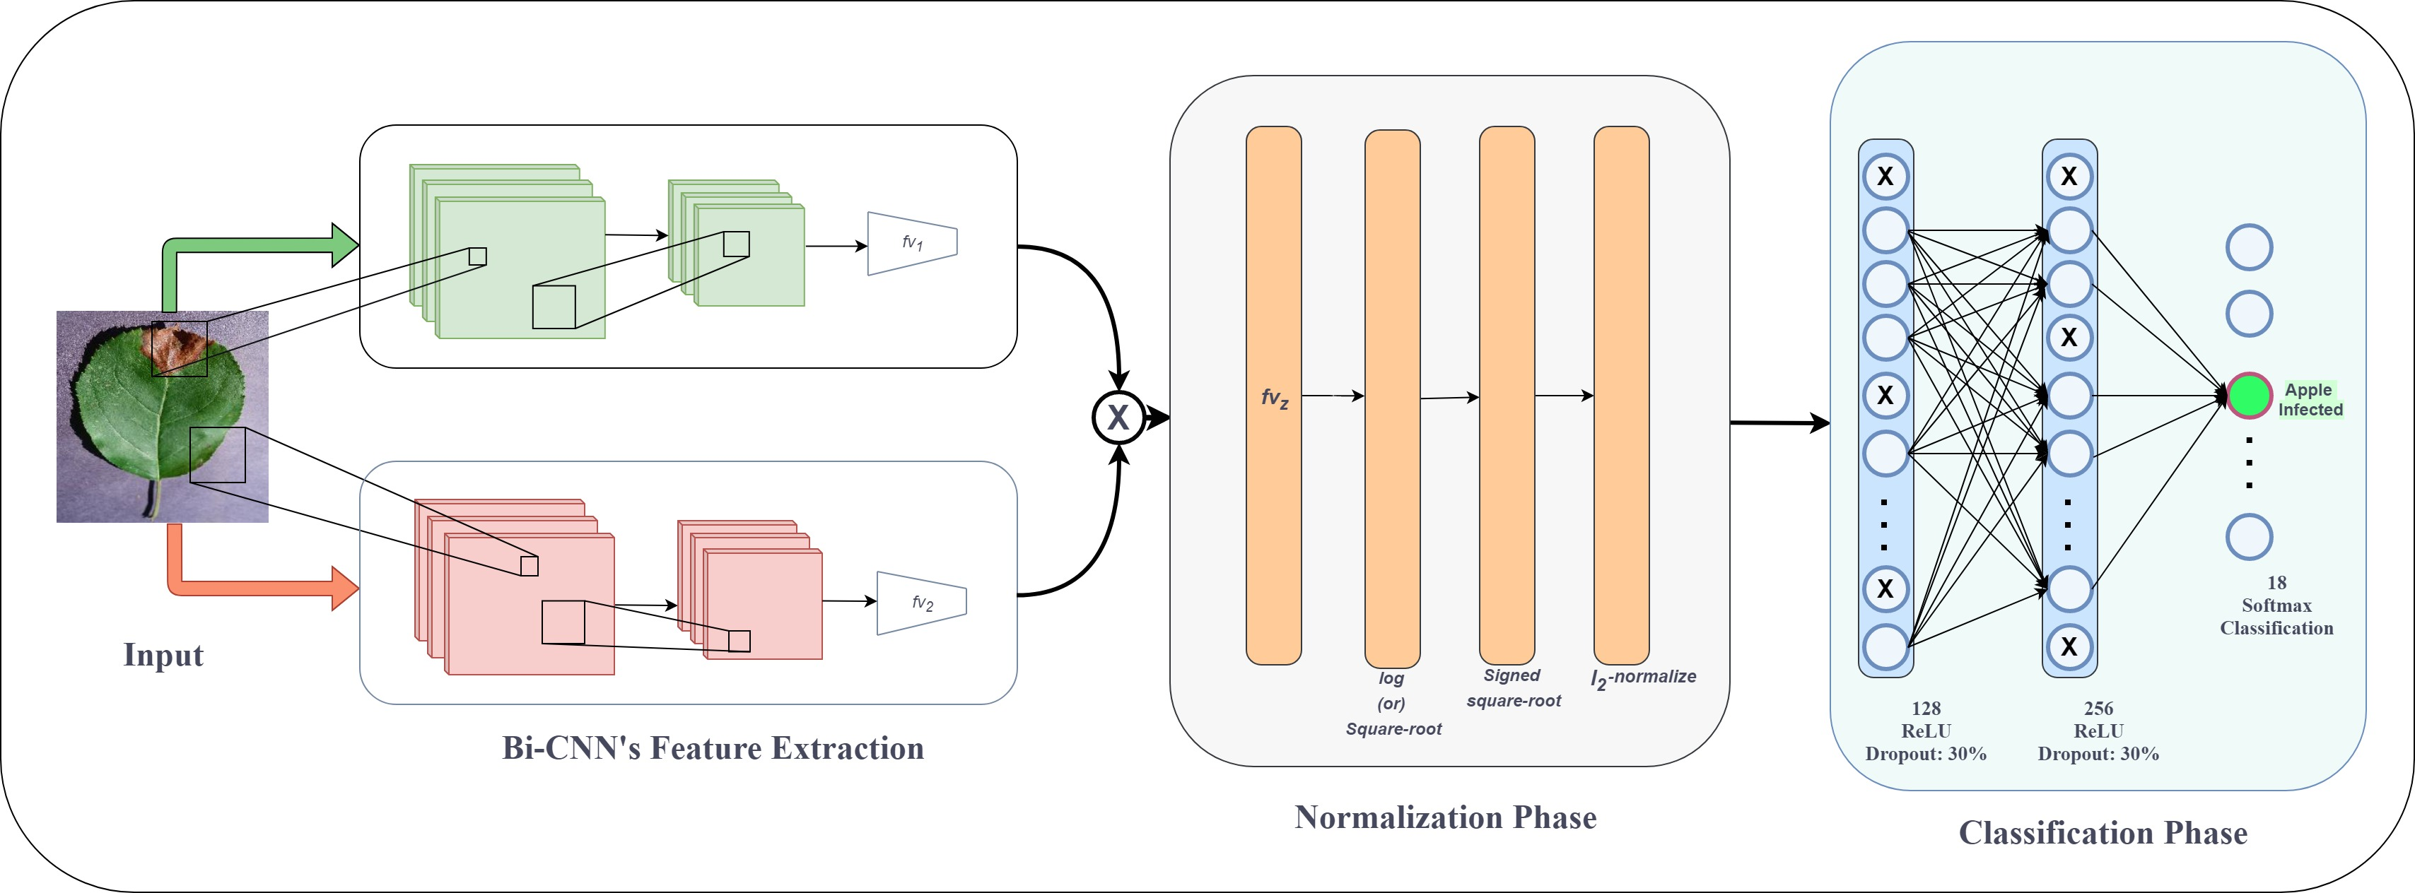
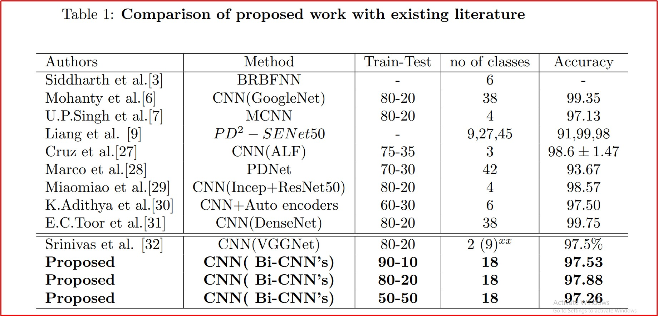
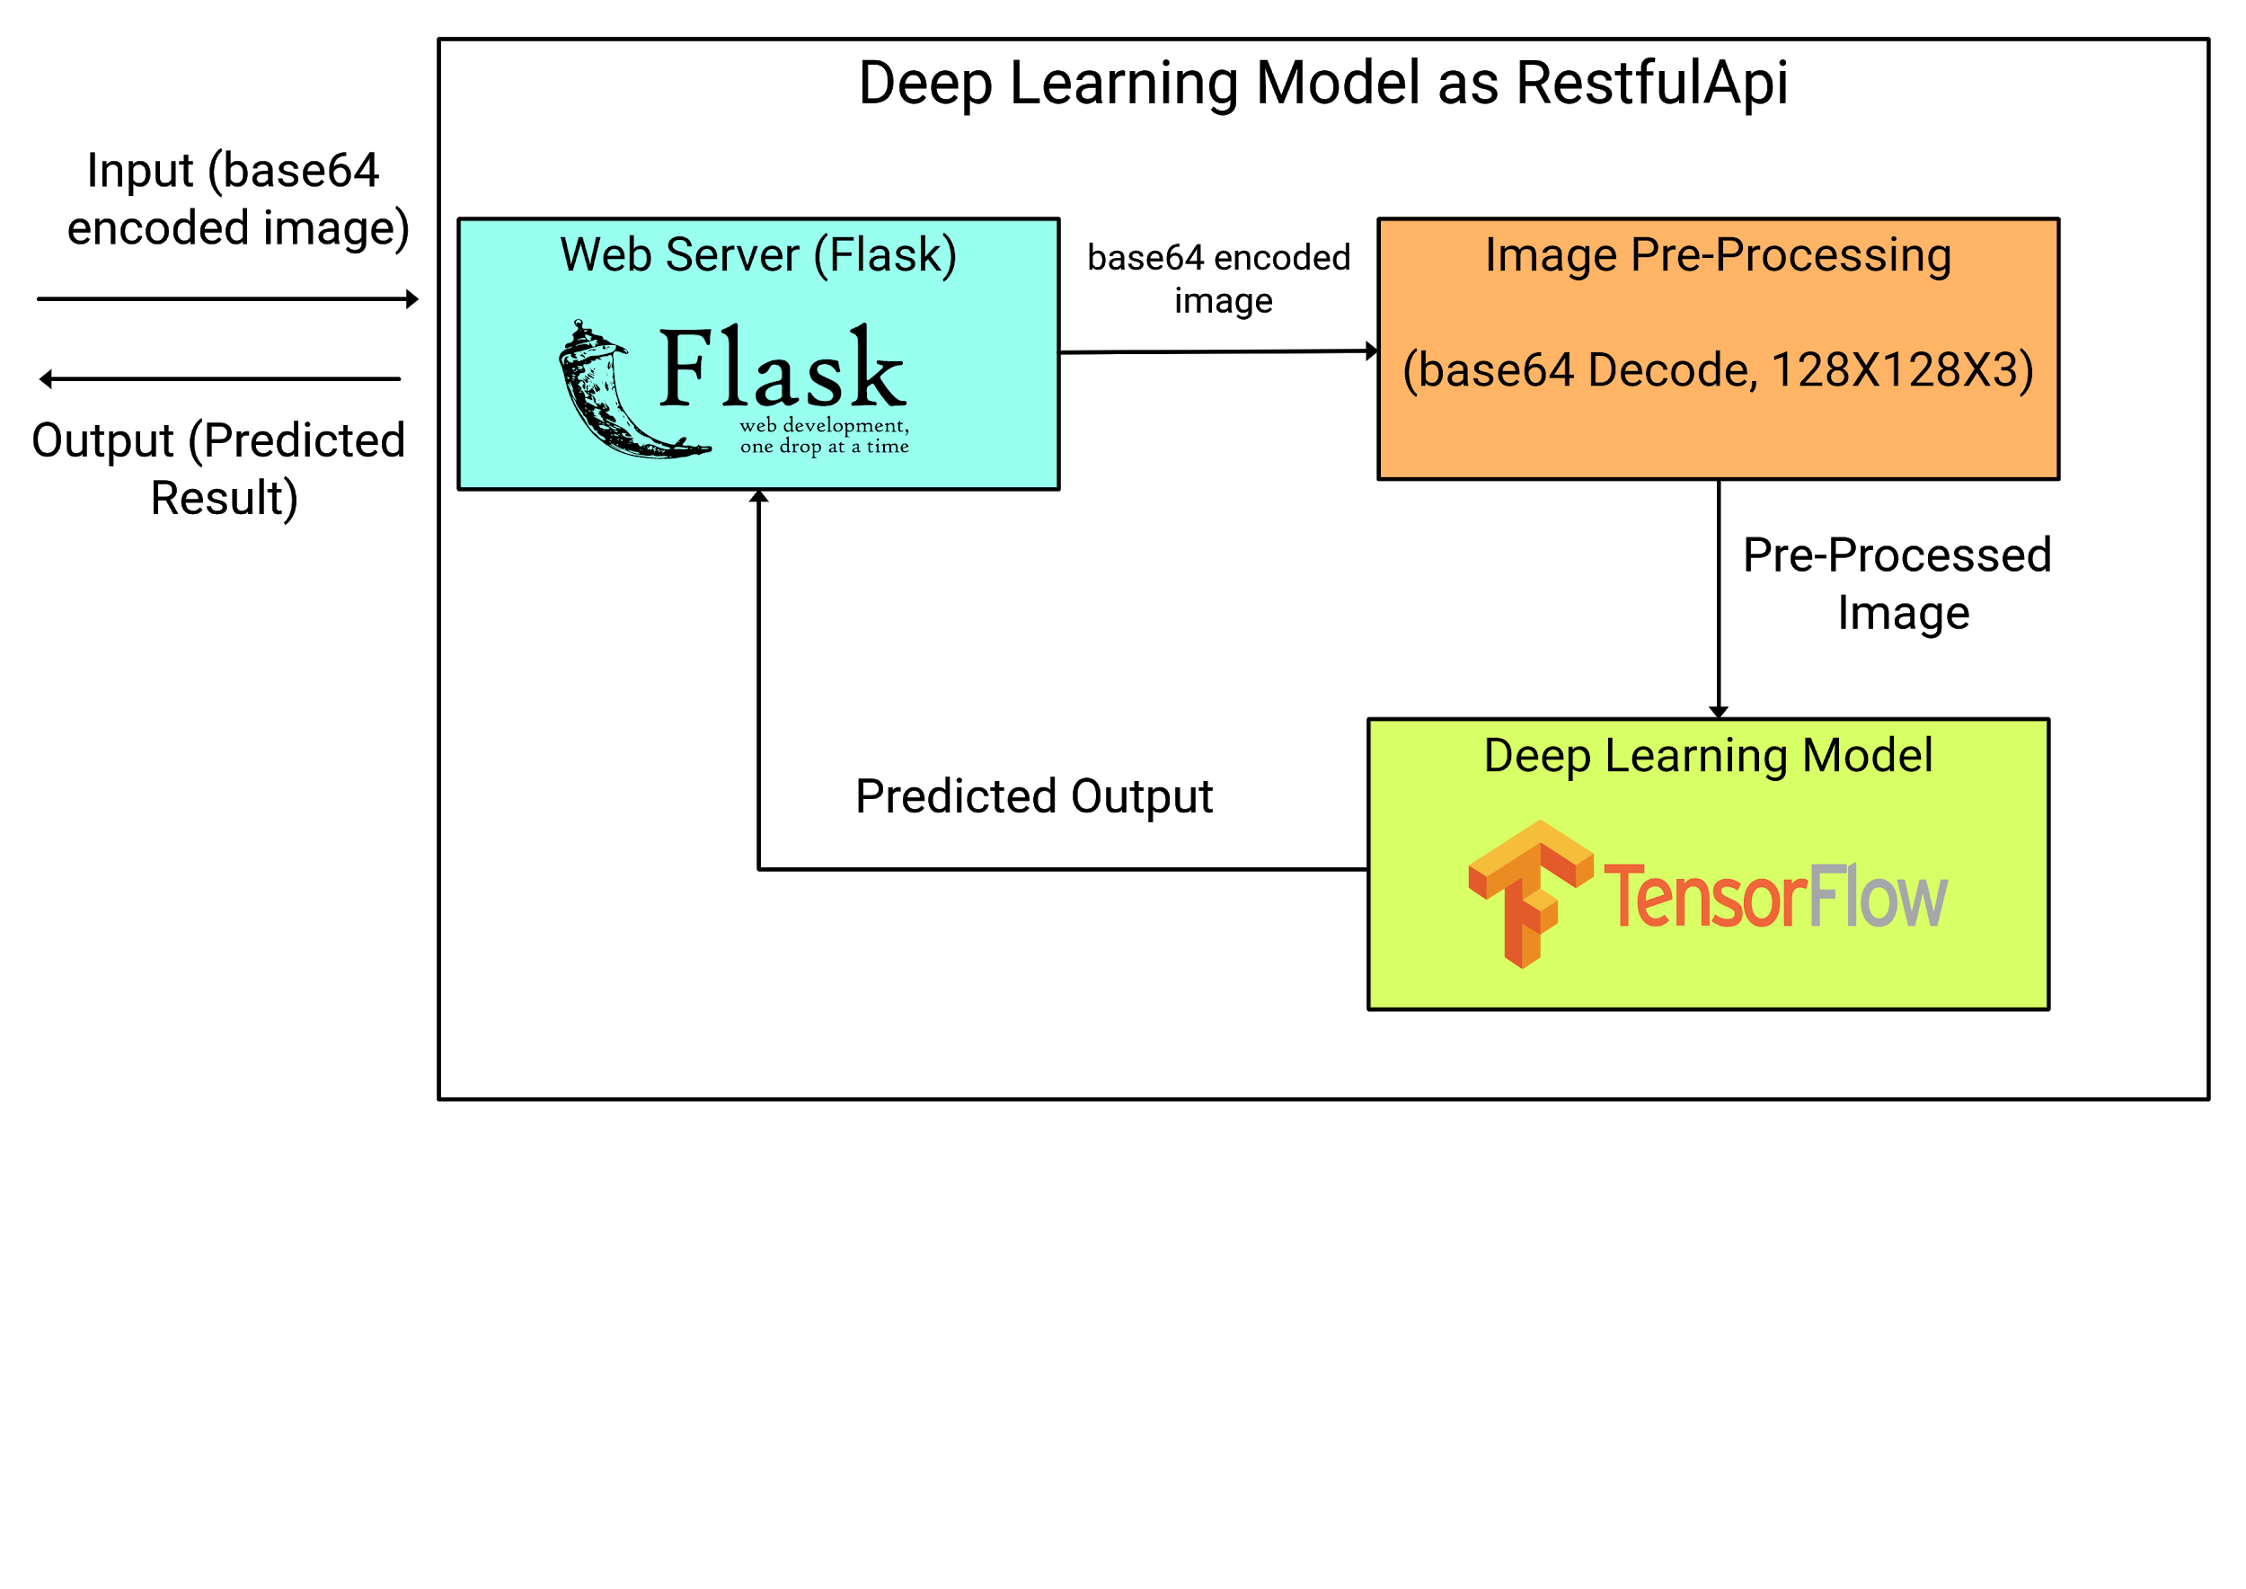
Plant Disease Detection and Classification with Convolution Neural Networks-an API oriented solution
Problem?
Plant diseases that occur through various sources is a threat which causes a huge loss in production of farming. Detection of infected plants is necessary to take required preventive measures to protect the plant and preserve it. As manual identification of the disease requires expertise to determine the pathological status of the plant regarding the infection levels. So, automated identification is preferred by driving human-level intelligence to the machine using deep-vision approaches to provide fast, reliable and accurate solutions.
Solution!
Stage I: Methodology-I
In this paper, we proposed, analyzed, and assessed various state-of-the-art models proposed over a decade. These models are pre-trained with the finest parameters where we modeled a design-oriented method with numerous leaf-images and classified them into infection and healthy class for each type of leaf independently.
Stage II: Methodology II
In this research, automated identification and classification of 9 distinct plant-leaves with healthy and infection classes is developed using Bi-Linear Convolution Neural Network (Bi-CNN’s). This neural architecture is constructed inspiring from the visual perception of the human brain with two cortical pathways. The hyperparameters are fine-tuned by the scheduling training procedure to attain faster convergence. The model is generalized on a triad of testing splits ranging from 10 to 50\%. This model is evaluated on various standard classification metrics and when testing samples are increased by 5x ( i.e. from 10 to 50\%) the deviation in the accuracy score is very minute (0.27\%) which resembles the resilience to unseen samples. The AUC obtained for all the models for variant test samples is at least 99.92\%. This model is deployed in the form of a light Restful mobile-API to provide a real-world user-friendly application to provide instant outcomes. Stage III: Deployment
A restful API is deployed executing the deep vision models in the back-end ( i.e., server) and visualizing the classified outputs in the front-end which is the UI. This API is an opensource, user-friendly, portable, fast, efficient and scalable. This UI doesn't persist any information regarding the user.
Authors names
RAL Tier1
Methodology
Performance (Results)
Implied methodology-I
AUC-ROC curves to determine performance
Class Activation Maps: Visualization of ROI via Visual Attention
Goodness of fit: Analysing the performance of models at 3 test levels
Implied methodology-II
Test-I
Test-II
Test-III
Comparison with previous research (for the past 4 years)
A real-world application
Guide: Dr. D. Srinivasa Rao,Assoc.Professor, IT Dept.
Research Assistants:
Boddeda Rohit (IV-CSE-04: 17071A06I7)
B Lalith Bharadwaj (IV-IT-01: 17071A1208)
Shilhora Akshay Patel (IV-IT-01:18075A1209)
Acknowledgements:

Slide 2

